Slide 1

Space Shooter
By:- Gautam Kumar Maurya
Supervised By:- Mr. Shashank Yadav

Slide 2
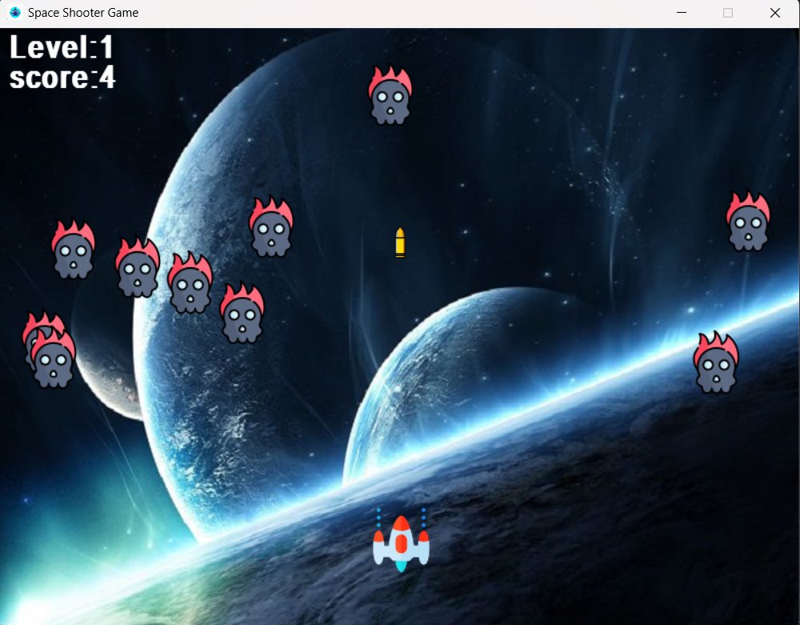
Introduction
Python is the programming language used to create the space shooter game project.
2. In the game, there is a single
spaceship that fires bullets at the
monsters.

Slide 3



Platform & Software
Windows
Visual studio
Python

Slide 4
Modules & Libraries
Pygame :- Pygame used for display image of background and monster and . space ship. All things are update in a loop.
2. Random :- Random used for to generate monster initial position
Mixer :- Mixer is used for play B.G music, Bullet fire music & hit music.
4. Math :- Math module used for to calculate distance b/w monster and . bullet to confirm the kill event.

Slide 5
Thank You

